Slide 1
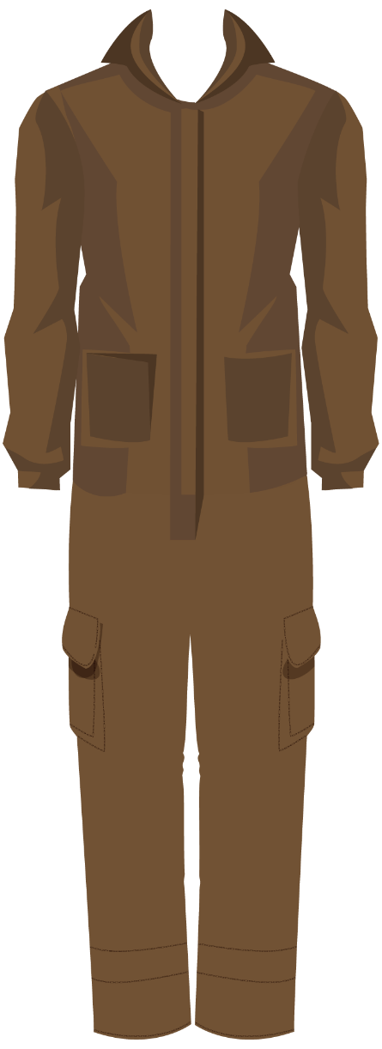
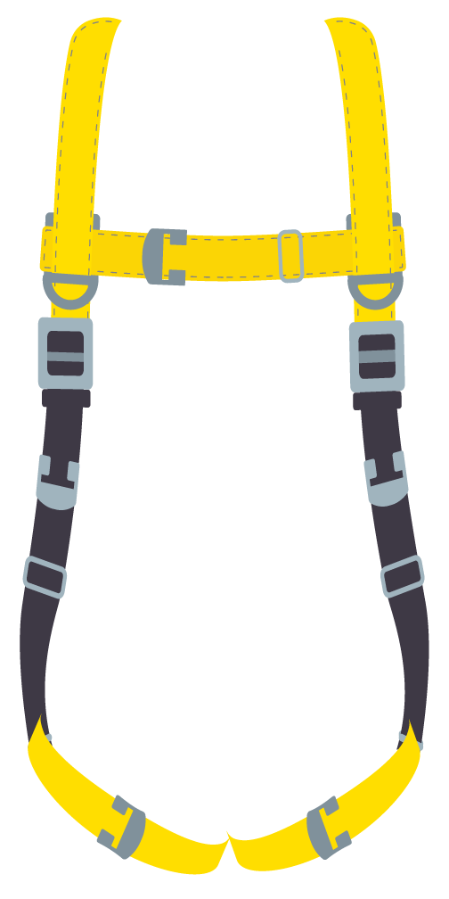
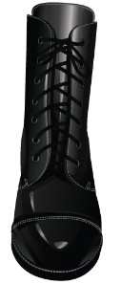
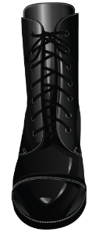
Dress the Miner
Controlling Hazards with PPE

Slide 2
This template is designed for activities to help trainees understand the hazards and controls miners may face in their daily work.
By incorporating real or realistic scenarios involving normal work tasks, trainees can analyze them to identify hazards, documents to consult, hazard control methods, and required permits.
Then trainees can dress the miner in the appropriate PPE needed for the scenario presented.
The following slides present the graphics used for the dress the miner activity so you can create a custom activity for your needs.
Then, an example scenario is presented for you to use as a basis for the scenarios you would like to develop for your trainees. Play the slideshow from slide 8 to see how it works.

Slide 3
Scenario
Describe the scenario here.
Add a picture here to depict your scenario.

Slide 4
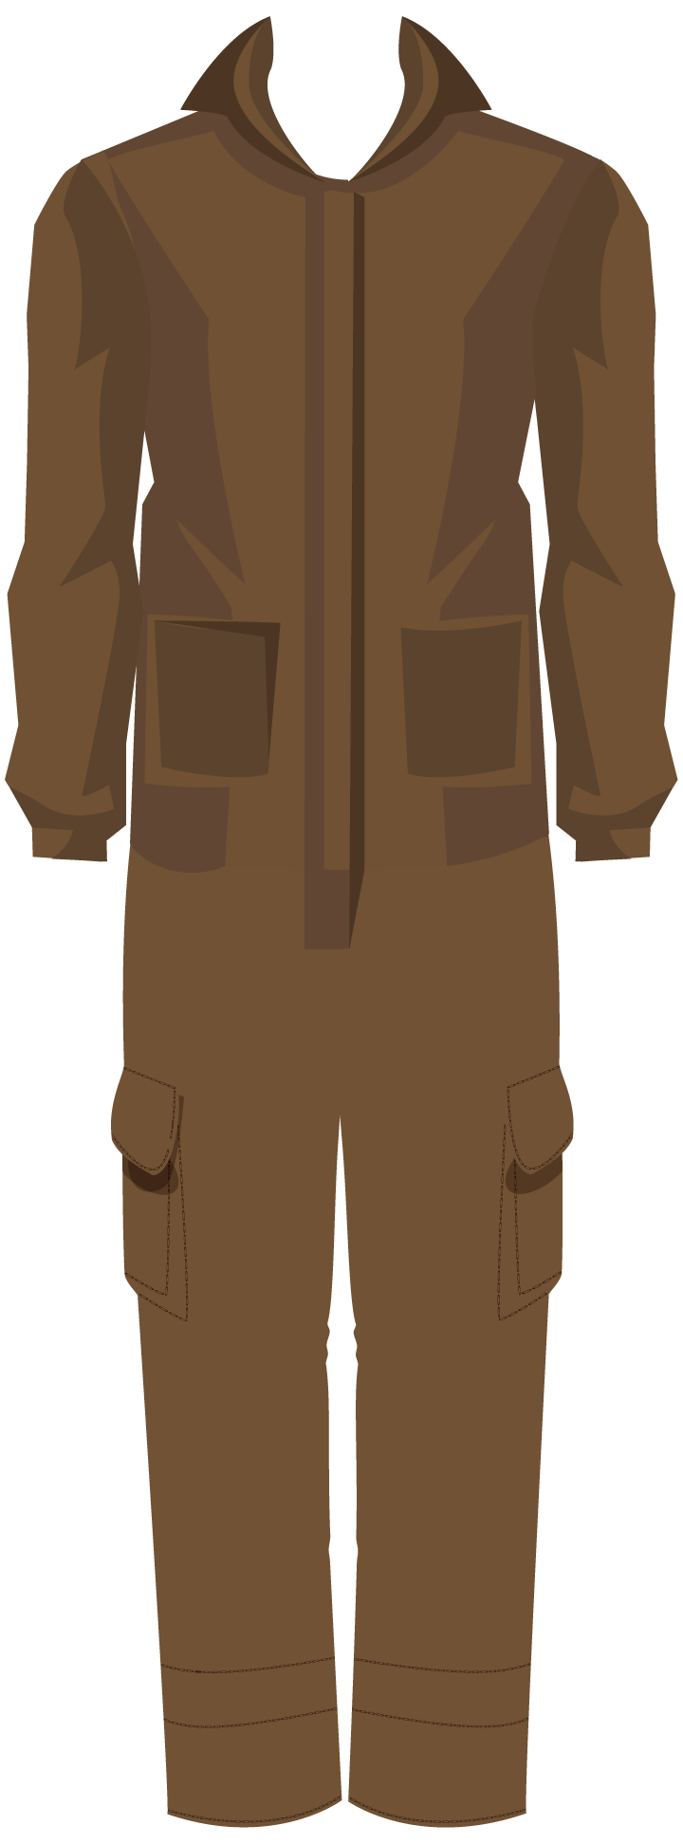

Slide 5
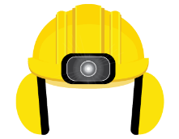
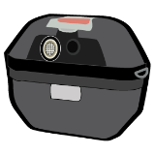

Slide 8
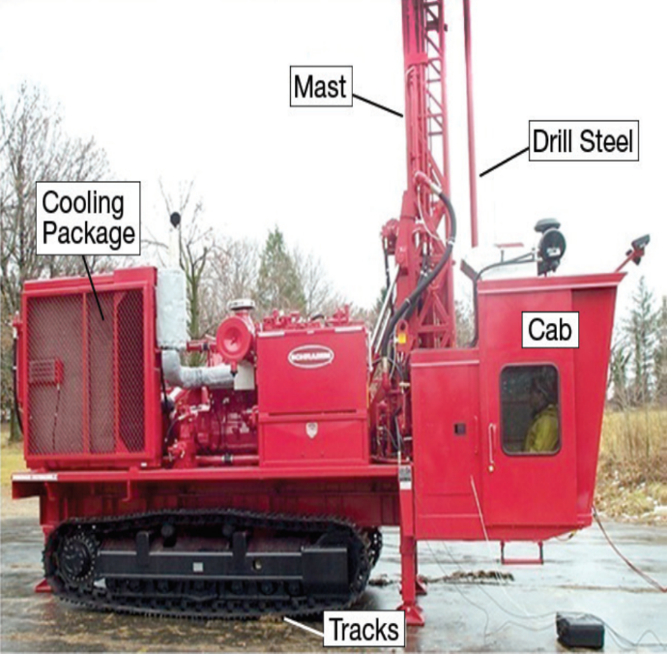
Example Scenario
You are a driller in the Rock Hard stone quarry and operate an air-rotary drilling rig in the quarry. A recent MSHA noise study found that workers had exposure levels between 91 and 112 dBA in the cab of the rig. Your specific exposure averaged 95 dBA during the time you spent drilling.
The company conducted tests to identify and isolate the dominant noise sources. Isolating the cause of the in-cab noise indicated that vibrations were transmitted from multiple hydraulic pumps to the control panel producing the dominant spike in the sound level spectrum.

Slide 9
Example Scenario
You are a driller in the Rock Hard stone quarry and operate an air-rotary drilling rig in the quarry. A recent MSHA noise study found that workers had exposure levels between 91 and 112 dBA in the cab of the rig. Your specific exposure averaged 95 dBA during the time you spent drilling.
The company conducted tests to identify and isolate the dominant noise sources. Isolating the cause of the in-cab noise indicated that vibrations were transmitted from multiple hydraulic pumps to the control panel producing the dominant spike in the sound level spectrum.

Slide 10
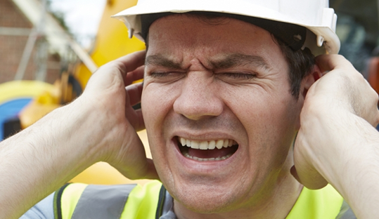
Main Hazards of Concern
Chemical/Dust Hazards
None
Safety Hazards
None
Physical Hazards
Exposure to noise

Slide 11
Exposure to Noise
How long can you be exposed at 95 dBA?
PEL for noise
Exchange rate for noise

Slide 12
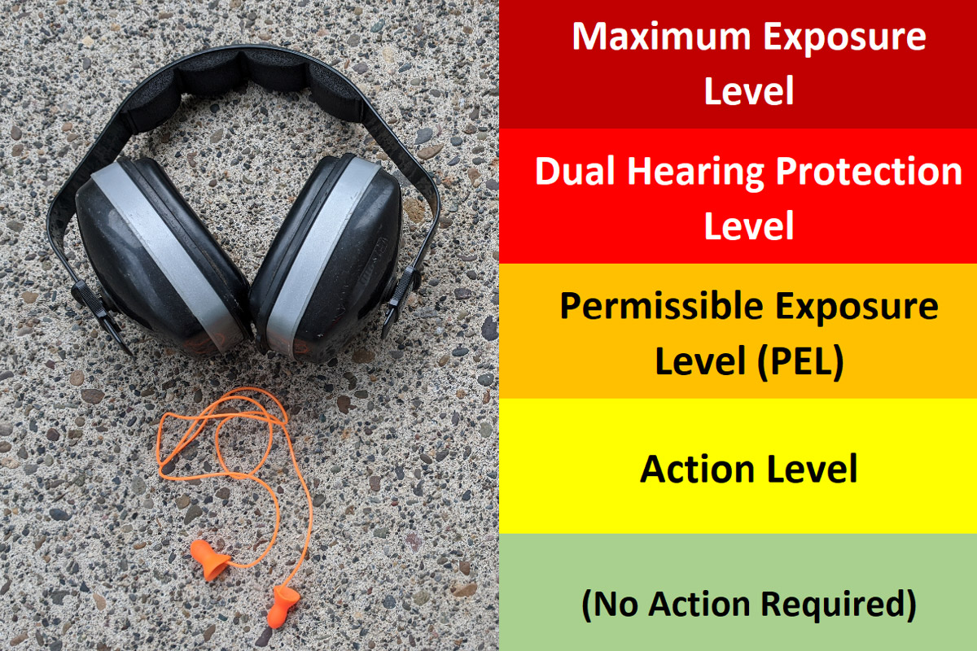
MSHA Exposure Limits for Noise
Maximum Exposure Level
115 dBA
Dual Hearing Protection Level
105 dBA TWA
Permissible Exposure Level (PEL)
90 dBA TWA
Action Level
85 dBA TWA
No Action
Required
<85 dBA TWA

Slide 13
MSHA Noise Exchange Rate
MSHA PEL – 90 dBA
MSHA Exchange Rate – 5 dB
Length of Exposure | MSHA (5 dB Exchange Rate)
16 Hours | 85 dBA
8 Hours | 90 dBA
4 Hours | 95 dBA
2 Hours | 100 dBA
1 Hour | 105 dBA
30 Minutes | 110 dBA
15 Minutes | 115 dBA
7.5 Minutes | 120 dBA
3.75 Minutes | 125 dBA
WORKER
Noise Exposure Triangle
DURATION
LOUDNESS
Notes:
Remove any element of the triangle and overexposure to noise is prevented.
Reduce loudness or duration and exposure is reduced.

Slide 14
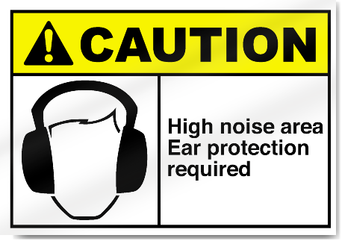
Employee Exposure to Noise
How long can you be exposed at 95 dBA?
4 hours
What, if any, actions must be taken?
Actions required by standard

Slide 15
Key Actions Required of Mine Operators
If a miner’s noise exposure… |  | Then… (Action Required by Mine Operator)
…is below the action level | <85 dBA TWA₈ | No action required
…equals or exceeds the action level, but does not exceed the PEL | 85 to <90 dBA TWA₈ | Enroll the miner in a hearing conservation program (HCP). Monitoring system Voluntary use of provided hearing protectors Voluntary audiometric testing Training Record keeping Ensure that the hearing protectors are worn if the miner has a standard threshold shift or it will be longer than 6 months before receiving a baseline audiogram.
…exceeds the PEL | >90 dBA TWA₈ | Use all feasible engineering and administrative controls to reduce miner’s noise exposure to the PEL. Enroll the miner in an HCP and ensure use of provided hearing protectors, if unable to reduce exposure to the PEL. Posts administrative controls and provides copy to affected miner.
…exceeds the dual hearing protection level | >105 dBA TWA₈ | Same as exceeds the PEL, plus ensure the concurrent use of provided ear plug and ear muff type hearing protectors.
…exceeds 115 dBA | >115 dBA | No miners, including those with dual hearing protectors, are permitted to be exposed to sound levels exceeding 115 dBA.

Slide 16
Employee Exposure to Noise
How long can you be exposed at 95 dBA?
4 hours
What, if any, actions must be taken?
Must be enrolled in a Hearing Conservation Program
Must wear hearing protection
Measure
Protect
Train
Evaluate
Control
Check
Record

Slide 17
Hazard Control Methods
Physical Hazards
Exposure to noise
Automate drilling operations
Reduce noise levels by changing out the hydraulic pumps
Enhance sound proofing of the cab to isolate the noise sources
Reduce time in cab drilling
Wear hearing protection

Slide 18
Dress the Miner
Notes:
Click on the PPE to dress the miner. If the correct PPE is chosen, the miner will don it. If incorrect PPE is chosen, an X will appear on the PPE, then choose again.

Slide 19
Dress the Miner

Slide 20
Dress the Miner
Appropriate dress
Work Wear
Work Gloves
Safety Shoes
Hard Hat
Hearing Protection
Safety Glasses

